Slide 1
Text Extraction and Web Scraping
unstructured data
big data
social media
Text Analytics
sentiment analysis
Topic 2

Slide 2
Topic Outline
1
Data Collection from Text Sources
Topic Two
2
Regular Expressions and String Handling
3
Web Scraping

Slide 3
Data Collection from Text Sources
Section 1:

Slide 4
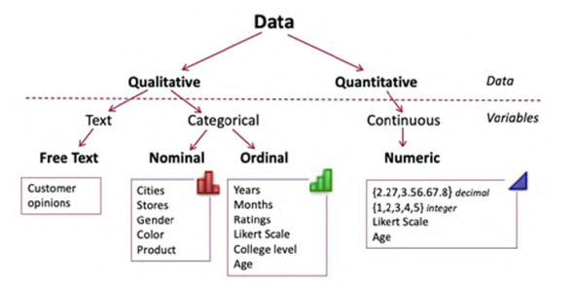
Source:
Andres Fortino (2021). Text Analytics for Business Decisions: A Case Study Approach. Mercury Learning and Information.

Slide 5
Sources of Textual Data
1
Primary Sources
Survey Responses
Interview transcriptions
Commercial sites - customer complaint letters, corporate reports
Emails
Secondary Sources
Online repository – newspaper articles, journal articles
Social Media Data
2

Slide 6
Sources of Textual Data
Survey Responses
To get direct responses from individuals based on the specific questions/topics being asked
How virtual learning can be improved in UNITEN?
Implement face to face classes
Wanted to do face to face learning after 2nd dose completed
Labs may be conducted physically/ Face to face lab
Materials should have good content about real time industrial evolution
Past year question to be include so that students easier to do revision.
Learning must be a 2-way communication
A more in depth with examples for virtual learning....
Interactive learning instead of giving lectures and a lot of assignments

Slide 7
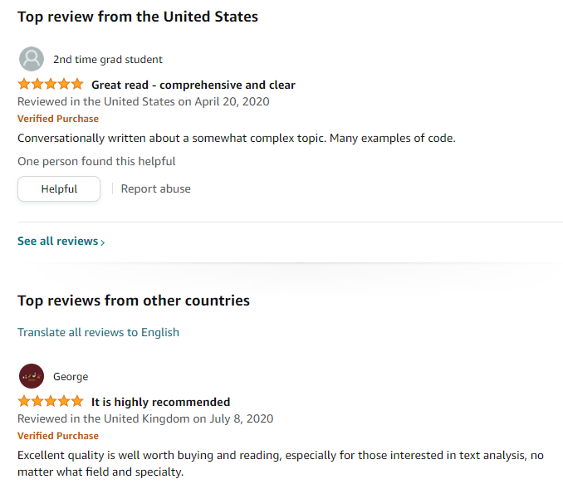
Sources of Textual Data
Commercial sites
Customer reviews/feedback
Customer opinions

Slide 8
Sources of Textual Data
Online repository
https://catalog.data.gov/dataset/consumer-complaint-database
http://corpus.byu.edu/coca
https://www.ebscohost.com/public/newspaper-source
https://archive.org

Slide 9
Sources of Textual Data
Social Media Data
Facebook
Twitter
LinkedIn
These data are generated in real time
How to process them:
Process the data stream in real time
Download the data stream for later processing

Slide 10
Class Exercise
Let’s brainstorm for a suitable topic for your Project
Identify a topic that involves textual data analysis

Slide 11
01
Planning Text Analytics Project
Problem Framing
Problem Framing
Data Generation
Analysis Decision Making
Problem Identification
Project Objective
Project Drivers
Data Generation
Project Scope
Data Collection
Sampling
Analysis Decision Making
Text Analytics Method Selection
Text Analytics Software Selection
Adapted from:
Practical Text Analytics: Maximizing the Value of Text Data by Murugan Anandarajan, Chelsey Hill, Thomas Nolan (2019); and
Text Mining and Analysis (1st Edition) - Practical Methods, Examples, and Case Studies Using SAS by Dr. Goutam Chakraborty; Murali Pagolu; Satish Garla

Slide 12
Problem Framing
Problem Identification:
The problem related to a certain topic
E.g. customer satisfaction of a particular product or service
Project Objective:
The text analytics problem and text analytical questions you aim to achieve
Measurable objectives that can be achieved by text analytics approach
E.g. sentiment analysis, topic modelling
Project Drivers:
Reasons for selecting the topic
E.g. product/service improvement

Slide 13
Data Generation
Project Scope:
The boundaries of your project
E.g. specific time period, specific data sources
Data Collection Instrument:
Data sources and collection methods
E.g. survey questionnaire, social media, online reviews
Sampling:
Target audience or sources of data collection

Slide 14
Possible Text Analytics Projects
Opinion on eateries available on campus
Feedback on resources available in the library
Customer reviews for a particular product/service
Social media discussions on a current event/trending topic
Key themes in academic research papers within a specific field

Slide 15
Project: Opinion on eateries at UNITEN
Problem Identification
Different opinions on available eateries in campus, affecting campus experience & satisfaction
Project Objective
To identify the overall satisfaction sentiments of the eateries in UNITEN
To identify the positive and negative aspect of the dining experience in UNITEN
To identify key themes in the opinions about UNITEN eateries
Project Drivers
Motivated by the importance of dining experience on student satisfaction

Slide 16
Project: Opinion on eateries at UNITEN
Project Scope:
All campus eateries, current semester, targeting students
Data Collection Instrument:
Survey questionnaire, UNITEN social media platforms
Sampling:
Students from various backgrounds & academic levels

Slide 17
Regular Expressions and String Handling
Section 2:

Slide 18
Imagine you needed to search a string for a term, such as “phone”. You can use the in keyword to do this:
“phone” in “Is the phone here?”
>>> True

Slide 19
Now imagine you need to find a telephone number, such as “408-555-1234”, you could do the same:
“408-555-1234” in “Her phone is 408-555-1234”
>>> True

Slide 20
But what if you didn’t know the exact number?
If all you knew was the format of the number: ###-###-#### you would need regular expressions to search through the document for this pattern.
Regular expressions allow for pattern searching in a text document.

Slide 21
Regular Expressions
A sequence of character(s) mainly used to find and replace patterns in a string or file
https://www.analyticsvidhya.com/blog/2015/06/regular-expression-python/
A special sequence of characters that helps you match or find other strings or sets of strings, using a specialized syntax held in a pattern
https://www.tutorialspoint.com/python/python_reg_expressions.htm

Slide 22
Regular Expressions
The most common uses of regular expressions are:
To search a string
To finding a string
To break string into a sub strings
To replace part of a string
https://www.analyticsvidhya.com/blog/2015/06/regular-expression-python/

Slide 23
Regular Expressions in Python
“re” module
This module provides regular expression matching operations
Regular expressions use TWO (2) types of characters:
Literals
a, b, c, A, B, C, 0, 1, 2, 3…
Metacharacters
. ^ $ * + ? { } [ ] \ | ( )

Slide 24
Regular Expressions in Python
1
Metacharacter [ ]
Used for specifying a set of characters to be matched.
Characters can be listed individually, or a range of characters can be indicated by giving two characters and separating them by a '-'.

Slide 25
Regular Expressions in Python
Example 1 – to search for characters ‘a’, ‘b’ and ‘c’
Method 1 – [abc]
Method 2 – [a-c]
Example 2 – to search for characters ‘a’, ‘b’ and ‘*’
Method 1 – [ab*]

Slide 26
Regular Expressions in Python
2
Metacharacter ^
Used to match characters within the class by complementing the set
Example 1 – to search for characters other than ‘a’
Method 1 – [^a] will return all characters in the string except ‘a’
Example 2 – to search for characters ‘a’ and ‘^’
Method 1 – [a^] will return the characters ‘a’ and ‘^’

Slide 27
Regular Expressions in Python
3
Metacharacter \
\ can be followed by various characters to signal various special sequences.
It’s also used to escape all the metacharacters so you can still match them in patterns

Slide 28
Regular Expressions in Python
Example 1 – to match any decimal digits
Method 1 – \d
Method 2 – [0-9]
Example 2 – to match any non-digit character
Method 1 – \D
Method 2 – [^0-9]
Example 3 – to match any whitespace character
Method 1 – \s
Method 2 – [\t\n\r\f\v]
Example 4 – to match any non-whitespace character
Method 1 – \S
Method 2 – [^\t\n\r\f\v]
Example 5 – to match any alphanumeric character
Method 1 – \w
Method 2 – [a-zA-Z0-9_]
Example 6 – to match any non-alphanumeric character
Method 1 – \W
Method 2 – [^a-zA-Z0-9_]

Slide 29
Regular Expressions in Python
4
Metacharacter *
Used to match either zero, one or many occurences
Example – to find zero, one or many occurrences of character ‘o’
bo*k
will return:
bk – zero character between ‘b’ and ‘k’
bok – 1 character (‘o’) between ‘b’ and ‘k’
book – 2 characters (‘oo’) between ‘b’ and ‘k’
boook – 3 characters (‘ooo’ ) between ‘b’ and ‘k’

Slide 30
* asterisk/star metacharacter
import re
str1 = "Numbers are 8,23, 886, 4567, 78453"
# asterisk sign(*) to match 0 or more repetitions
result = re.findall(r"\d\d*", str1)
print(result)
# Output ['8', '23', '886', '4567', '78453']

Slide 31
Regular Expressions in Python
5
Metacharacter +
Used to match either one or many occurences
Example – to find one or many occurrences of character ‘o’
bo*k
will return:
bok – 1 character (‘o’) between ‘b’ and ‘k’
book – 2 characters (‘oo’) between ‘b’ and ‘k’
boook – 3 characters (‘ooo’ ) between ‘b’ and ‘k’

Slide 32
+ Plus metacharacter
import re
str1 = "Numbers are 8,23, 886, 4567, 78453"
# Plus sign(+) to match 1 or more repetitions
result = re.findall(r"\d\d+", str1)
print(result)
# Output ['23', '886', '4567', '78453']

Slide 33
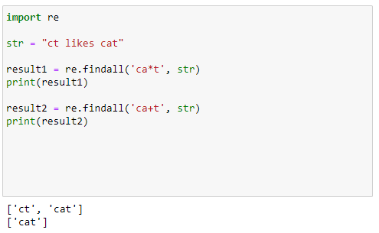
Regular Expressions in Python
Metacharacter * and +

Slide 34
Regular Expressions in Python
6
Metacharacter ?
Used to match either one or zero occurence
Example – to find one or zero occurrences of character ‘o’
bo*k
will return:
bk – zero character between ‘b’ and ‘k’
bok – 1 character (‘o’) between ‘b’ and ‘k’

Slide 35
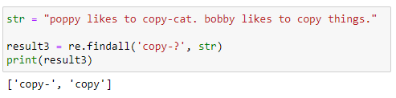
Regular Expressions in Python
Metacharacter ?

Slide 36
Regular Expressions in Python
7
Metacharacter { }
Used to match the occurences based on the specified min and max values
Example – to find one up to 3 occurences of ‘o’
bo{1,3}k
will return:
bok – 1 character ‘o’
book – 2 characters ‘o’
boook – 3 characters ‘o’

Slide 37
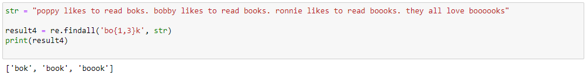
Regular Expressions in Python
Metacharacter { }

Slide 38
Web Scraping
Section 3:

Slide 39
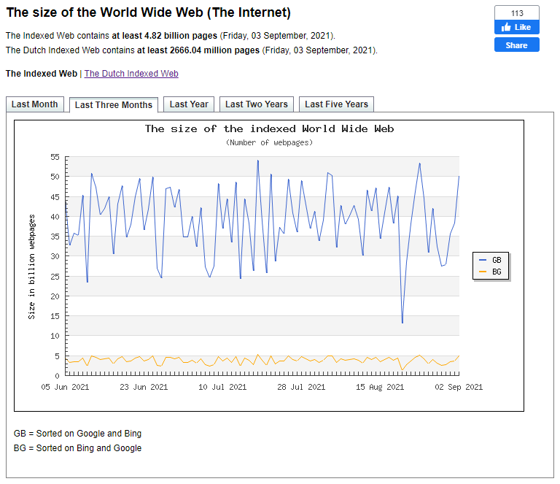
The size of World Wide Web
World Wide Web (WWW) has become the most popular method to disseminate information; thus, there is an information overload on the Web.
Source:
https://www.worldwidewebsize.com/

Slide 40
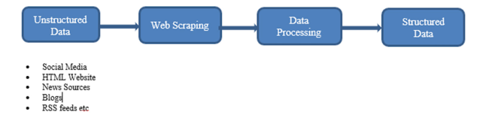
Definition of Web Scraping
The extraction of data from a website where the extracted data is collected and then exported into a format that is more useful for the user.
Web scraping data flow
Source: https://www.parsehub.com/blog/what-is-web-scraping/

Slide 41
Essential Python Libraries for Web Scraping
Request
Used for sending and receiving information on HTTP - helps us access Web pages
Beautiful Soup
Used to extract data from HTML and XML documents
Scrapy
A complete framework that can crawl like a spider to fetch information from the entire website in a systematic manner
Selenium
A powerful library that automates to open a browser of your choice and perform a task as a human, such as clicking buttons, entering information on forms, and so on.

Slide 42
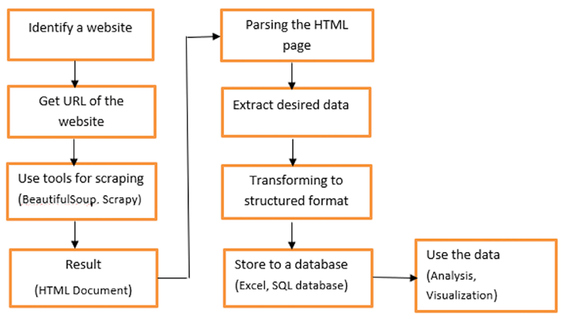
Web Scraping Process

Slide 43
The requests library
The first thing we’ll need to do to scrape a web page is to download the page. We can download pages using the Python requests library.
The requests library will make a GET request to a web server, which will download the HTML contents of a given web page for us.
Let’s try downloading a simple sample website, https://dataquestio.github.io/web-scraping-pages/simple.html.

Slide 44

Running request
After running our request, we get a Response object. This object has a status_code property, which indicates if the page was downloaded successfully:

Slide 45
Parsing a page with BeautifulSoup
We can use the BeautifulSoup library to parse this document and extract the text from the p tag.
We first have to import the library, and create an instance of the BeautifulSoup class to parse our document:

Slide 46
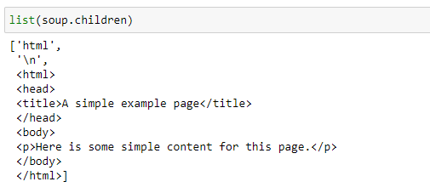
Parsing a page with BeautifulSoup
As all the tags are nested, we can move through the structure one level at a time. We can first select all the elements at the top level of the page using the children property of soup.
Note that children returns a list generator, so we need to call the list function on it:

Slide 47
Selecting tag
The most important object type, and the one we’ll deal with most often, is the Tag object.
The Tag object allows us to navigate through an HTML document and extract other tags and text. You can learn more about the various BeautifulSoup objects here.
We can now select the html tag and its children by taking the third item in the list:

Slide 48

Extract the desired data
Print the extracted data

Slide 49

Store extracted data

Slide 50
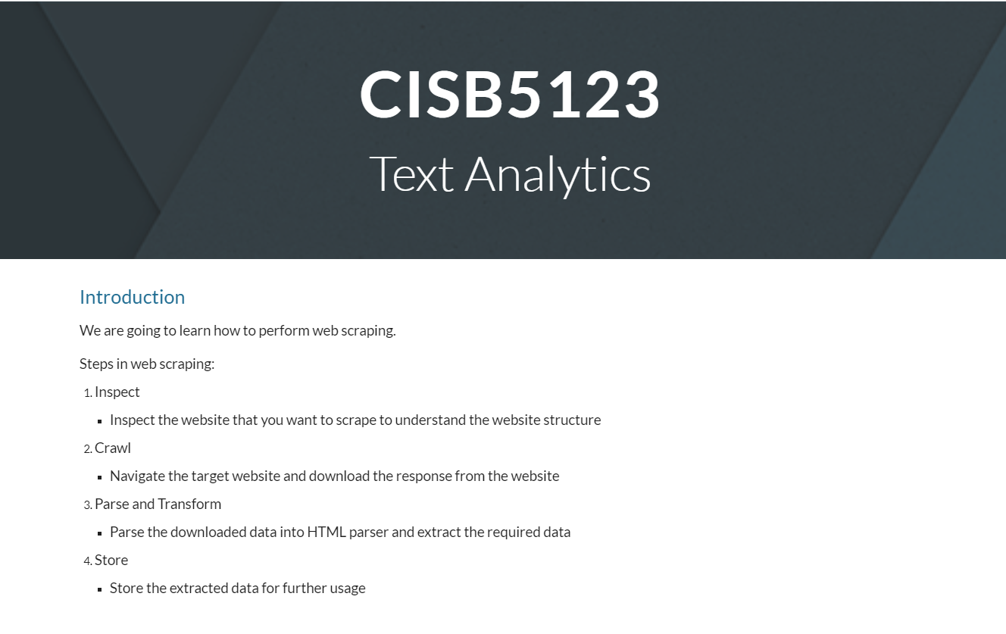
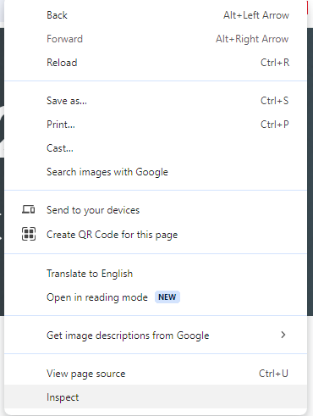
We want to scrape this site:
https://sites.google.com/view/cisb5123/home

Slide 51
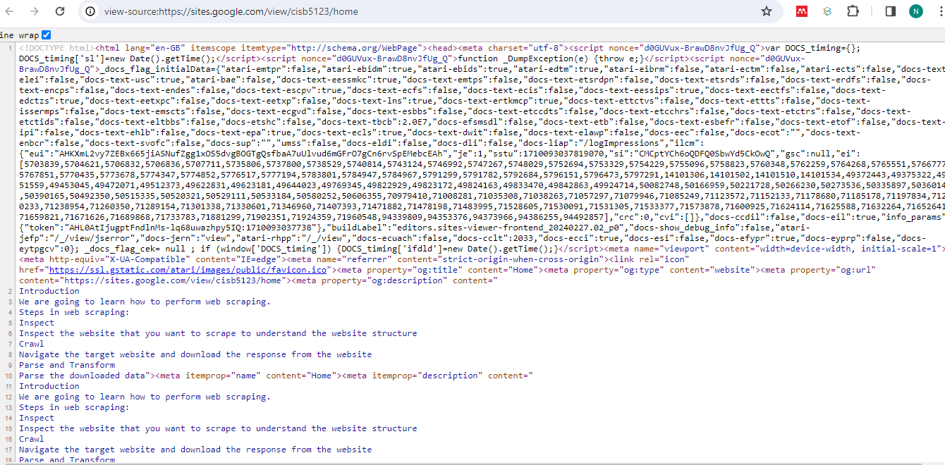
To view the location of a particular entity on a Web page like text or image, select that portion of the Web page and then right-click and choose "Inspect Element"/"View Source". In such a case, the page will show the exact location of the selected content in the HTML code of the page.
https://webformatter.com/html

Slide 52
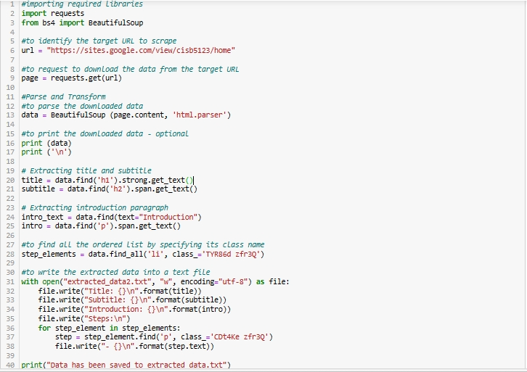

Slide 53
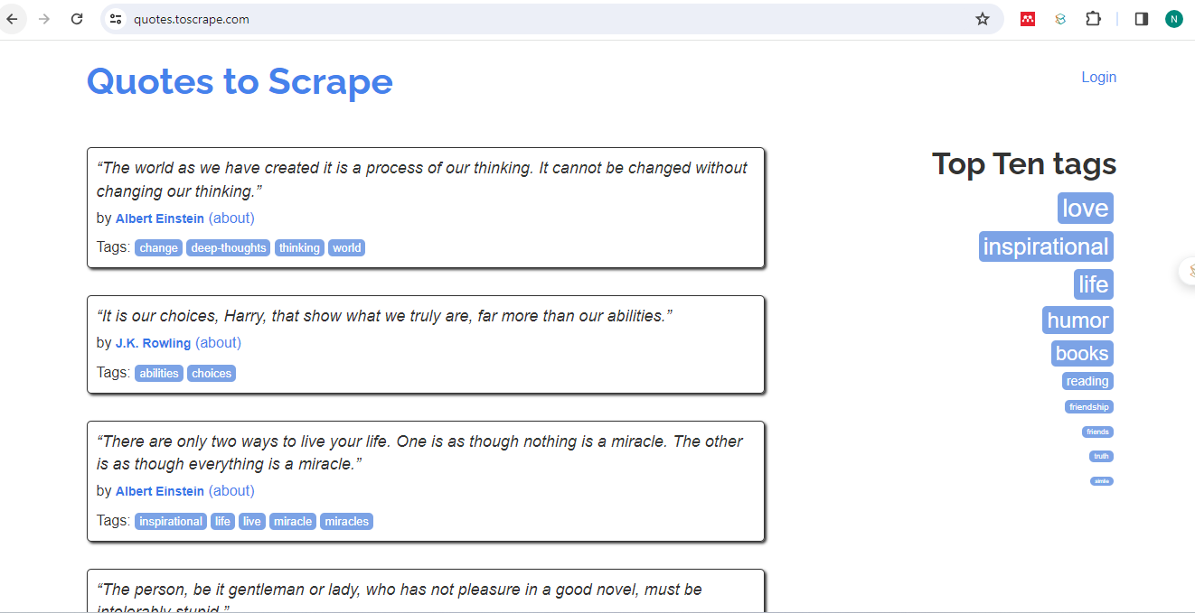
Let’s scrape another site:
https://quotes.toscrape.com/

Slide 54
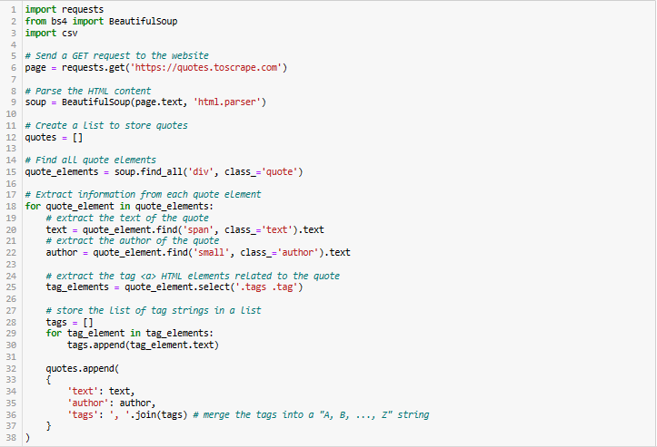

Slide 55
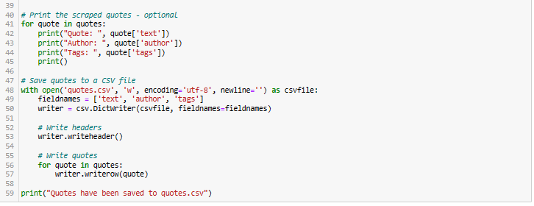

Slide 56
Challenges of Web Scraping
Site structure may change over a period of time
The technology used by the site may also change over a period of time
Legality of the scraped data
Ethical issues
Organizations’ privacy may also be unintentionally revealed

Slide 57
Legality of Web Scraping
Following guidelines can be followed before proceeding for scraping:
Robots.txt
Public Content
Terms of use
Crawl delay
Authentication rules

Slide 58
Thank
you

